Slide 1
6.2 Robotics
Robots and robotics

Slide 2
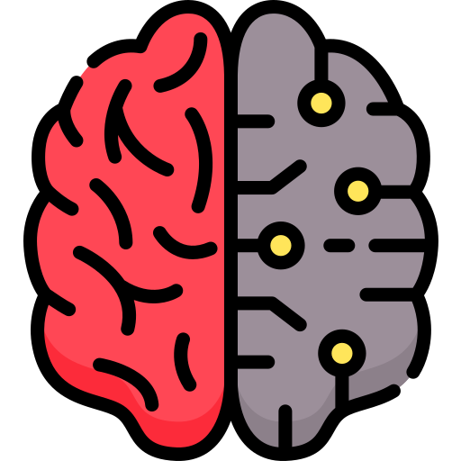
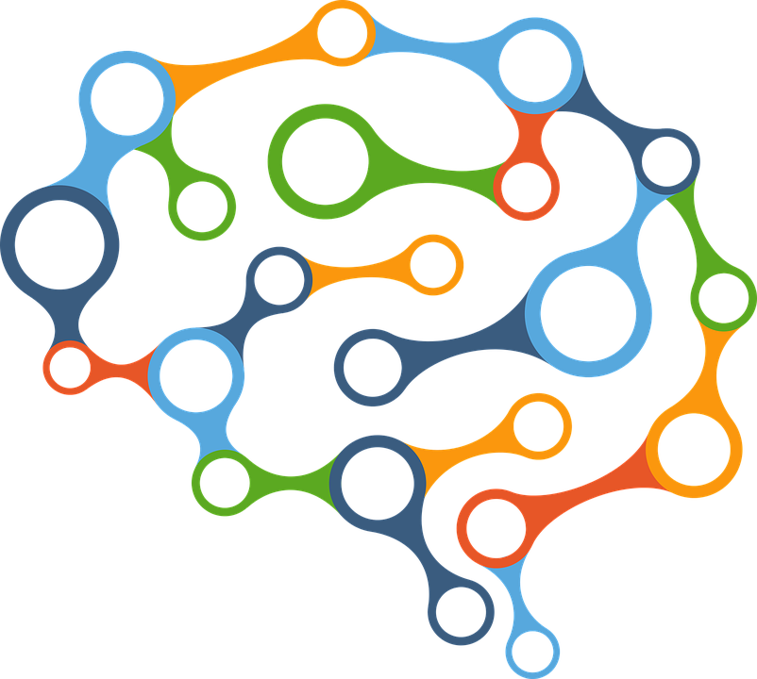

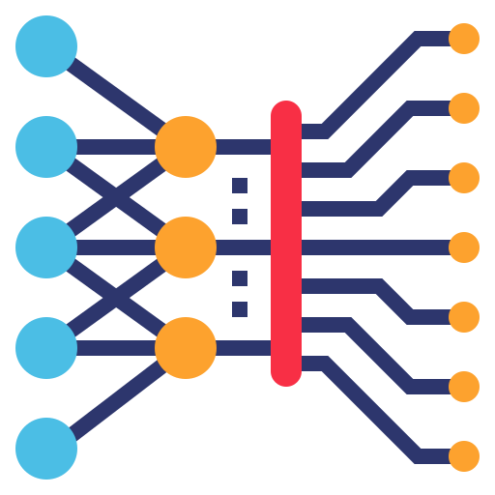
Artificial intelligence, machine learning and robotics
There is a lot of hype around the emerging technologies of artificial intelligence and machine learning and what they could mean for the future of robotics and automation.
However, there is also a lot of confusion surrounding these terms because they are often used interchangeably.
So, what does each term actually mean, and how do they relate to each other?
Artificial intelligence
Machine learning
Robotics

Slide 3


Artificial intelligence
“For the present purpose, the artificial intelligence problem is taken to be that of making a machine behave in ways that would be called intelligent if a human were so behaving.”
John McCarthy, American computer scientist who coined the term artificial intelligence in 1956.
A broad term that describes any machine programmed to simulate intelligent behaviours.
Covered in more detail in the following videos:
6.3 Artificial intelligence (AI)
6.3 Basic operations and components of AI systems
"null0" (https://commons.wikimedia.org/wiki/File:John_McCarthy_Stanford.jpg) John McCarthy Stanford
https://creativecommons.org/licenses/by-sa/2.0/legalcode

Slide 4
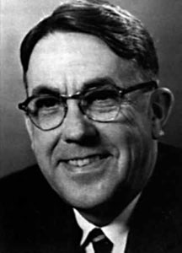
Machine learning
“The ability to learn without being explicitly programmed.”
Arthur Samuel, pioneer in computer gaming and AI who coined the term “machine learning" in 1959.
Machine learning is a subset of AI – in other words, it is one way to achieve artificial intelligence.
The science of training a device or application to perform a task and improve its capabilities.
Covered in more detail in the following videos:
6.3 Artificial intelligence (AI)
6.3 Basic operations and components of AI systems
Xl2085 (https://commons.wikimedia.org/wiki/File:This_is_the_photo_of_Arthur_Samuel.jpg), https://creativecommons.org/licenses/by-sa/4.0/legalcode

Slide 5
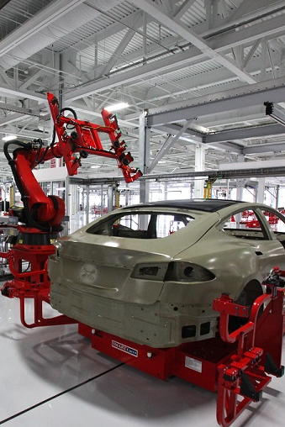
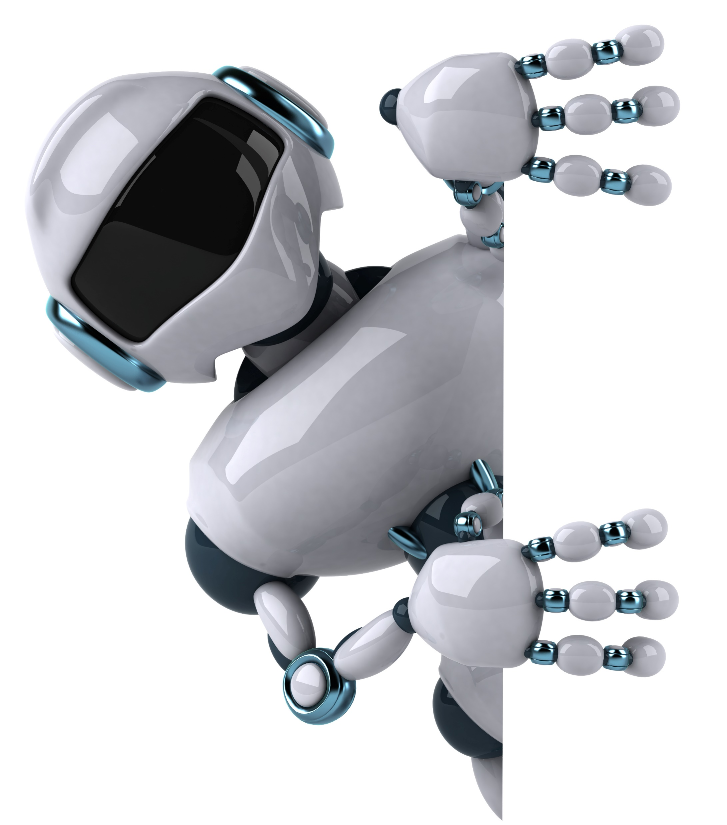
Robotics
The term robotics often gets thrown around in association with AI – but not all robots are smart.
What is a robot?
“A machine that carries out work by itself by following a set of programmed rules.”

Slide 6
Robotics
The term robotics often gets thrown around in association with AI – but not all robots are smart.
What is a robot?
“A machine that carries out work by itself by following a set of programmed rules.”
Dumb robots
Simply repeat the same tasks over and over – no AI involved.
Smart robots
Trained to learn, adapt and carry out progressively more complex tasks.
Car assembly line
A robot designed to beat a human at chess

Slide 7



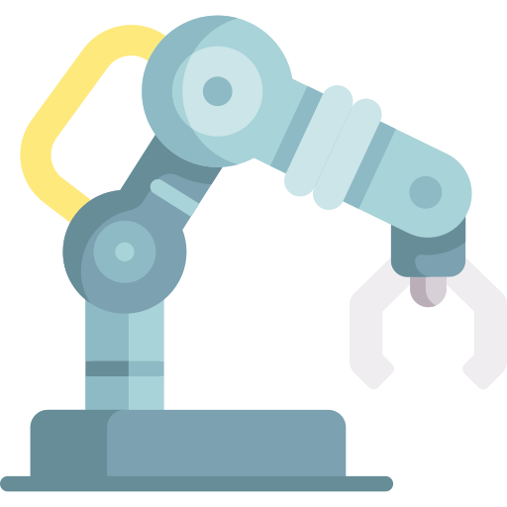




Characteristics of a robot
In very simple terms, you can think of the broad characteristics of all robots as falling into three categories.
Mechanical structure or framework
Electrical components
Programmability
Sensors
Microprocessors
Actuators

Slide 8

Robots and robotics
Robotics is a branch of computer science that incorporates the design, construction and operation of robots.
Includes factory equipment, domestic robots and drones.
A robot is a machine that works by itself by following a set of programmed rules.
Some robots can be dumb – they simply repeat the same tasks over and over.
Some robots exhibit AI/machine learning – they are trained to carry out more complex tasks and adapt.
Robots share similar characteristics:
A mechanical structure or framework
Electrical components
Programmability

Slide 9


